Slide 1
AZ-900T01 Module 04: Azure pricing and support

Slide 2
Lesson 01: Learning objectives

Slide 3
Module 4 – Learning objectives
Understand and describe Microsoft Azure subscriptions and management groups
Recognize ways to plan and manage Azure costs
Understand Azure support options
Understand and describe features of Azure Service Level Agreements (SLAs)
Understand and describe the service lifecycle in Azure

Slide 4
Lesson 02: Azure subscriptions

Slide 5
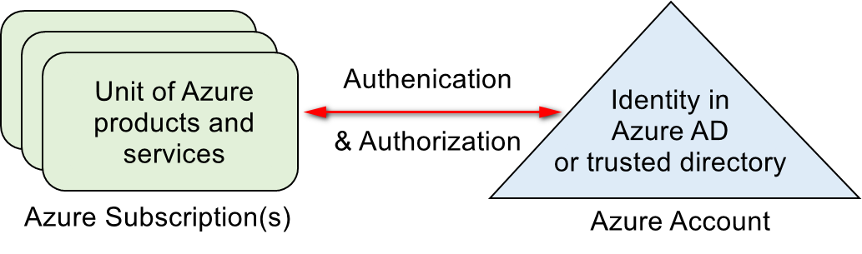
Azure subscriptions
An Azure subscription provides you with authenticated and authorized access to Azure products and services and allows you to provision resources on Azure. It is a logical unit of Azure services that links to an Azure account.
Azure offers free and paid subscription options to suit different needs and requirements. An account can have one subscription or multiple subscriptions that have different billing models, and to which you apply different access-management policies.

Slide 6
Subscription uses and options
You can use Azure subscriptions to define boundaries around Azure products, services, and resources.
Two types of subscription boundaries that you can use:
Billing boundary. This subscription type determines how an Azure account is billed for using Azure. You can create multiple subscriptions for different types of billing requirements.
Access control boundary. Azure will apply access management policies at the subscription level, and you can create separate subscriptions to reflect different organizational structures.
Several other subscription types to choose from include the Free account and Pay-As-You-Go.
Notes:
You can select from a range of Azure subscription options, including:
A free subscription. This subscription is for 30 days and includes a $200 credit. This allows you unlimited access to the free Azure products and then a limit of $200 to spend on the paid products. Your Azure services are disabled when the trial ends or when your credit expires for paid products, unless you upgrade to a paid subscription.
Pay-As-You-Go subscription. This subscription allows you to pay for what you use by attaching a credit or debit card to your account. Organizations can apply to Microsoft for invoicing privileges.
Member offers. Your existing membership to certain Microsoft products and services affords you credits for your Azure account and reduced rates on Azure services. For example, member offers are available to Microsoft Visual Studio subscribers, Microsoft Partner Network members, Microsoft BizSpark members, and Microsoft Imagine members.
You could also menti that there are subscription service limits, as per here https://docs.microsoft.com/en-us/azure/azure-subscription-service-limits
For more information on Azure subscription offers, refer to https://azure.microsoft.com/en-us/support/legal/offer-details/

Slide 7
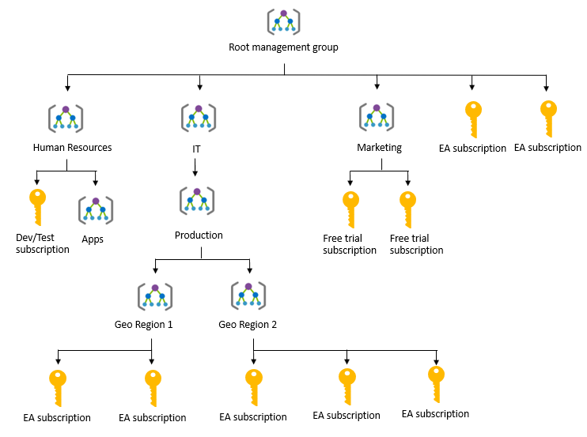
Management groups
Azure Management groups are containers for managing access, policies, and compliance across multiple Azure subscriptions
Management groups allow you to order your Azure resources hierarchically into collections, which provide a further level of classification beyond subscriptions.
Notes:
You can manage your Azure subscriptions more effectively by using Azure Policy and Azure role-based access controls (RBACs). These provide distinct governance conditions that you can apply to each management group. The resources and subscriptions you assign to a management group automatically inherit the conditions that you apply to that management group.
You can point out the presence of management groups for Human resources, IT with sub management groups for Production and then for different geographies, there is also one for Marketing. These are helping divide up and make the usage more manageable.
For more information about management groups, refer to:
https://docs.microsoft.com/en-us/azure/governance/management-groups/

Slide 8
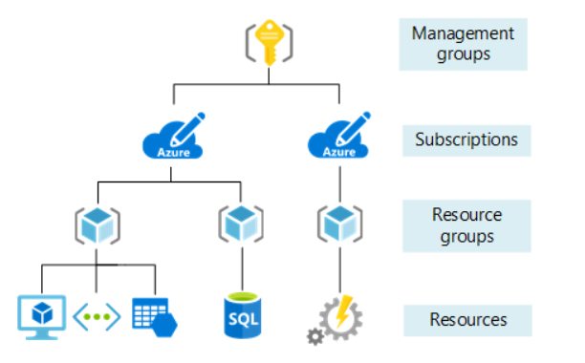
Object Hierarchy
The organizing structure for resources in Azure has four levels:
Notes:
- Management groups: These are containers that help you manage access, policy, and compliance for multiple subscriptions. All subscriptions in a management group automatically inherit the conditions applied to the management group.
- Subscriptions: A subscription groups together user accounts and the resources that have been created by those user accounts. For each subscription, there are limits or quotas on the amount of resources you can create and use. Organizations can use subscriptions to manage costs and the resources that are created by users, teams, or projects.
- Resource groups: A resource group is a logical container into which Azure resources like web apps, databases, and storage accounts are deployed and managed.
- Resources: Resources are instances of services that you create, like virtual machines, storage, or SQL databases

Slide 9
Walkthrough-Manage Subscriptions and Management groups
In this walkthrough task we will create Azure Subscriptions and create Management groups to manage those subscriptions. We will then elevate the logged in user account access and add our subscriptions to our Management groups. We will then assign an Azure Policy for allowed locations to a Management group and subscription. We will then delete an Azure Subscription and delete the Management groups.
You can complete this walkthrough task by completing the steps outlined below, or you can simply read through them, depending on your available time
Notes:
In this walkthrough task we will create Azure Subscriptions based on organization structure and specific project use, we will then create Management groups to manage those newly created subscriptions. We will then elevate the logged in user account access, to allow it to manage all Azure subscriptions and management groups and add our subscriptions to our Management groups. We will then assign an Azure Policy for allowed locations to a Management group and subscription. We will then delete an Azure Subscription and delete the Management groups.
Prerequisites
You require need an Azure subscription to perform these steps. If you don't have one you can create one by following the steps outlined on the Create your Azure free account today webpage.
costs for running resources. You can delete all deployed resources by deleting the resource group in which they all reside.
Steps
Create Subscriptions based on organization structure and specific project use
1. In the Azure Portal select Subscriptions from the left-hand side FAVORITES menu and on the subscriptions pane click + Add
Note: The subscriptions listed in your Subscription pane will be different to what is displayed in the screenshot.
2. Sign into your Azure account when prompted, and in the subsequent Add subscription under the Select an Offer section, select Pay-As-You-Go
3. In the subsequent Azure Pay-As-You-Go signup page, under the Identity verification by phone section, ensure the Country code and Phone number details are correct then select either Text me or Call me and follow the prompts to complete the identity validation process.
4. In the Payment information either accept the existing payment method or add a new one and follow the prompts by clicking the Add a new payment method link and when complete click Next
5. In the Add technical support section select the radio button for No technical support... and click Next
6. In the Agreement section check the checkbox for I agree to the subscription agreement.... and click the Sign Up button
7. You will be taken then to the Quickstart Center page in the Azure Portal. If you have time you can take a moment click on the Open > link in the Introduction to Azure Setup and read through some of the Steps and details available within it, such as Organize resources and then the Azure management groups and hierarchy tab. You will also receive a mail informing you that your Azure subscription is ready.
8. Return Subscriptions pane and verify your new subscription is listed under subscriptions. If it is not displaying you may have to uncheck the box Show only subscriptions selected in the global subscriptions filter
9. Double click on the subscription to open it, and in the Pay-As-You-Go pane, note the various fields and data available, then go to the Overview section and click Rename
10. In the Subscription name blade enter a user friendly name based on an organization structure i.e. IT Department, and click Save, and close the pane.
Note: After you update the name, it may take some time for the portal to reflect the change. Please try refreshing the page after approx. 5 minutes.
11. Return to the Subscriptions pane and verify the newly renamed subscription is present.
12. Repeat Steps 1 to 12 to create another Pay-As-You-Go subscription, entering the same data entered previously when required except this time, use the subscription name New Product Launch. When finished both newly created subscriptions should be present in the Subscriptions pane.
Note: Creating multiple subscriptions and naming them for specific purposes allows us manage them more easily, particularly from a security and billing/cost management perspective. We could also create subscriptions specific to other criteria such as geography, workload or any other requirement you have to differentiate resources.
Create Management groups to manage newly created subscriptions
If your organization has many subscriptions, you may need a way to efficiently manage access, policies, and compliance for those subscriptions. Azure Management groups provide a level of scope above subscriptions. You organize subscriptions into `containers` called Management groups and then apply your governance conditions to the Management groups. If you have multiple subscriptions in a Management group this helps to greatly simplify the management of those subscriptions. The key aspect is to create Management groups representing various parts of your business or your needs, and placing subscriptions in those Management groups, which will have similar management requirements.
1. In the Azure Portal select Cost Management + Billing from the left hand side FAVORITES menu and then go to Management groups and click on the Start using management groups button
2. In the Add management group pane fill in the following details and click Save when finished.
- Create New: Check radio button
- Management group ID: contosomgmtgrptIDDepts (unique identifier that is used to submit commands on this management group)
- Management group display name: Contoso Departments Mgmt Grp (name that is displayed within the Azure portal)
Note: We will create a management group to help organize our our departmental subscriptions.
3. Repeat steps 1 and 2 and create another management group, using the below values, clicking Save when finished. This time we create a management group to hold projects that a company may be undertaking, such as Marketing initiatives, product launches etc
- Create New: Check radio button
- Management group ID: contosomgmtgrptIDProjects (unique identifier that is used to submit commands on this management group)
- Management group display name: Contoso Projects Mgmt Grp (name that is displayed within the Azure portal)
4. Both Management groups should display when completed.
Elevate logged in user access, to allow the account to manage all Azure subscriptions and Management groups
1. Still in the Cost Management + Billing pane under the Management groups section there is a message present stating You are registered as a directory admin but do not have the necessary permissions to access the root management group.
Note: Each directory is given a single top-level management group called the Root management group. This root management group is built into the hierarchy to have all management groups and subscriptions fold up to it. This root management group allows for global policies and RBAC assignments to be applied at the directory level. The Azure AD Global Administrator needs to elevate themselves to the User Access Administrator role of this root group initially. After elevating access, the administrator can assign any RBAC role to other directory users or groups to manage the hierarchy.
2. In the Azure portal or the Azure Active Directory and then go to Manage > Properties and under Access management for Azure resources, set the toggle to Yes, then click Save
When you set the toggle to Yes, you are *assigned* the User Access Administrator role in Azure RBAC at the root scope (/). This grants you permission to assign roles in all Azure subscriptions and management groups associated with this Azure AD directory. This toggle is only available to users who are assigned the Global Administrator role in Azure AD.
When you set the toggle to No, the User Access Administrator role in Azure RBAC is *removed* from your user account. You can no longer assign roles in all Azure subscriptions and management groups that are associated with this Azure AD directory. You can view and manage only the Azure subscriptions and management groups to which you have been granted access.
Add subscriptions to your Management groups
1. Go to Cost Management + Billing from the left hand side FAVORITES menu, then go to Management groups, double click on the Contoso Departments Mgmt Grp and then click on the details link
2. In the Contoso Departments Mgmt grp pane, in the Overview section click on the + Add subscription button and in the Add subscription blade, in the Subscription drop down list select IT Department, then click Save
3. Go to Cost Management + Billing then Management groups , double click on the Contoso Departments Mgmt grp and verify the IT Department subscription is now listed.
4. Repeat steps 1 and 3 this time for the below management group and subscription.
- Management group = Contoso Projects Mgmt Grp
- Subscription = New Product Launch
5. Go to Cost Management + Billing then Management groups , double click on the Contoso Projects Mgmt Grp and verify the New Product Launch subscription is now listed.
We could create more subscriptions, for company departments such as HR, Marketing, Dev etc and Projects, then add those subscriptions to the management groups and then apply policies and access control settings across them as we wish.
Assign Azure Policy for allowed locations to a Management group and subscription
We will now assign a policy to a Management group and subscription
1. Open Azure Policy then under the Authoring section, go to Definitions, search for the definition Allowed Locations, double click on it when located, and in the Allowed Locations - policy definition pane click the Assign button. Then in the Scope pane click the *ellipsis* three dots alongside Scope and select the Contoso Project Mgmt Grp management group, and then the subscription New Product Launch, then click the Select button.
2. Under the Parameters section, from the drop down list select a region i.e. West India then click Assign.
The subscription New Product Launch now requires all of its resources to be deployed to West India only. A case where this might be useful is related to a product launch, Marketing initiative taking place in West India. This policy has been applied at Management group level and is applicable to the subscription selected. You could also assign many of the other out of box policies at this management group level to apply to multiple subscriptions, or divide them up as most suitable to your organization and apply various policies needed.
Delete Azure Subscriptions
1. Go to Subscriptions and double click on the IT Department subscription, go to Overview section and then select Cancel subscription
2. In the Are you sure you want to cancel subscription IT Department? pane type the subscription name, i.e. IT Department and select reason for cancellation and then click Cancel Subscription.
You will receive an email stating Since you cancelled your subscription, we’ve disabled your services. We’ll keep your account and any associated data for 90 more days before deleting them on < some date >. Please log in and save any important data you may have stored in this subscription before then. The subscription will remain listed in the Subscription pane for period of time before it is no longer present.
3. Repeat steps 1 and 2 for the New Product Launch subscription.
4. In the subscription Overview pane, approx. 10-15 minutes after deletion, despite the subscription still being listed, the status is listed as Disabled and a Re-activate button is now present, both indicating the subscription is no longer active, while it is waiting to be completely removed.
Delete Management groups
To delete a management group, the following conditions must be met:
- There are no child management groups or subscriptions under the management group.
- You have write permissions on the management group ("Owner", "Contributor", or "Management Group Contributor"). You can see what permissions you have in the Management group Access control (IAM) pane.
As a result of these conditions, we will not be able to delete the management group until the subscription has been deleted, or we move the subscription out of the management group. We will move the subscription.
1. Open to the Contoso Departments Mgmt Grp and under the Overview section click the *ellipsis* alongside the IT Departments subscription and select Move from the subsequent context menu
Note: The Delete button on the Management group page is currently greyed out.
2. In the Move pane, from the New parent management group dorp down list choose the Tenant Root Group (GUID) then click Save
Note the message saying moving a subscription may affect policies and access.
3. Back in the Contoso Departments Mgmt Grp pane and under the Overview section, note that the subscription is no longer present and the Delete button is now no longer greyed out. Click Delete and in the Delete group prompt click Yes
The management group is deleted and no longer present.
4. Repeat steps 1 to 3 for the Contoso Projects Mgmt Grp and management group and the New Product Launch subscription.
Congratulations! You have created Azure Subscriptions based on organization structure and specific project use, you then created Management groups to manage those newly created subscriptions. You then elevated the logged in user account access, to be able to manage all Azure subscriptions and management groups and then added our subscriptions to our Management groups. You then assigned an Azure Policy for allowed locations to a Management group and subscription. You then deleted your Azure Subscriptions and Management groups.
Note: Remember to delete the resources you have just deployed, if they are still present and you are no longer using them to ensure you do not incur costs for running resources. You can delete all deployed resources by deleting the resource group in which they all reside.

Slide 10
Lesson 03: Planning and managing costs

Slide 11
Purchasing Azure products and services
Three main customer types on which the available purchasing options for Azure products and services are contingent are:
Enterprise: Enterprise customers sign an Enterprise Agreement with Azure that commits them to spending a negotiated amount on Azure services, which they typically pay annually.
Web direct: Web direct customers sign up for Azure through the Azure website.
Cloud solution providers (CSPs): Typically are Microsoft partner companies that a customer hires to build solutions on top of Azure. Payment and billing for Azure usage occurs through the customer's CSP.
Products and services in Azure are arranged by category, such as compute and networking, which have various resources that you can provision.
Notes:
Products and services in Azure are arranged by category, which have various resources that you can provision. You select the Azure products and services that fit your requirements, and your account is billed according to Azure's pay-for-what-you-use model.
Usage meters
When you provision an Azure resource, Azure creates one or more meter instances for that resource. The meters track the resources' usage, and each meter generates a usage record that is used to calculate your bill.
For example, a single virtual machine that you provision in Azure might have the following meters tracking its usage:
Compute Hours
IP Address Hours
Data Transfer In
Data Transfer Out
And more
For more information about purchasing Azure products and services, refer to https://azure.microsoft.com/en-us/pricing/purchase-options/

Slide 12
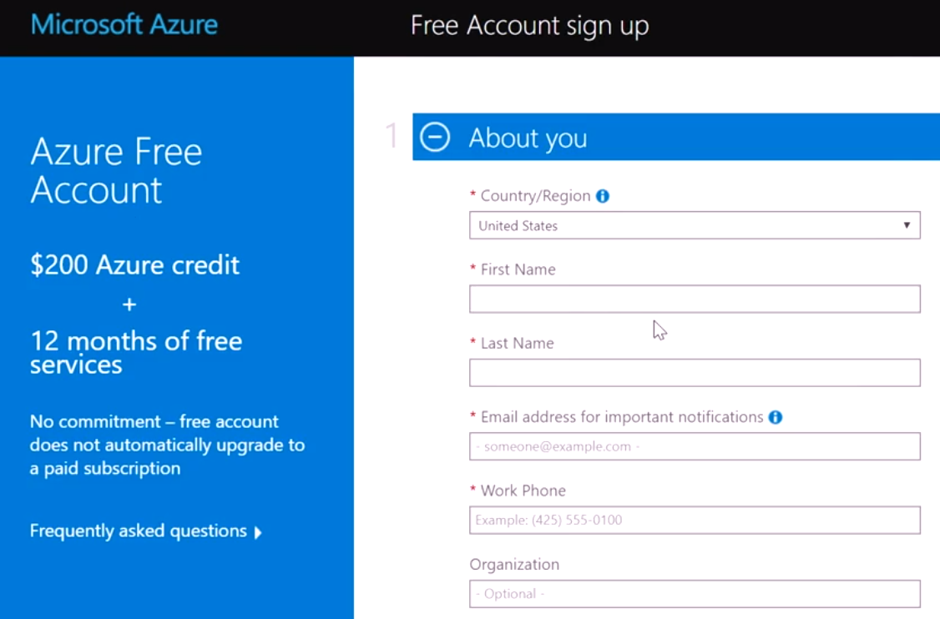
Azure free account
An Azure free account provides subscribers with a $200 USD Azure credit that they can use for paid Azure products during a 30-day trial period.
Once you use that $200 USD credit or reach your trial's end, Azure suspends your account unless you sign up for a paid account.
Notes:
If you upgrade to a Pay-As-You-Go subscription within the 30-day trial period, by providing your credit or debit card details you can use a limited selection of free services for 12 months. After 12 months, you will be billed for the services and products in use on your account at the pay-as-you-go rate.
For more information about Azure free accounts, refer to https://azure.microsoft.com/en-us/free/

Slide 13
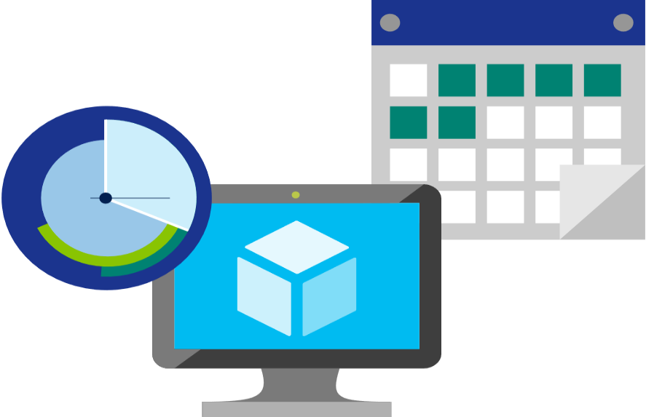
Factors affecting costs
There are three primary factors affect costs:
Resource Type: Costs are resource-specific, so the usage that a meter tracks and the number of meters associated with a resource depend on the resource type.
Services: Azure usage rates and billing periods can differ between Enterprise, Web Direct, and CSP customers.
Location: The Azure infrastructure is globally distributed, and usage costs might vary between locations that offer particular Azure products, services, and resources.
Notes:
For more information about Azure usage charges, refer to https://docs.microsoft.com/en-us/azure/billing/billing-understand-your-invoice

Slide 14

Zones for Billing Purposes
Bandwidth refers to data moving in and out of Azure datacenters. Some inbound data transfers are free, such as data going into Azure datacenters. For outbound data transfers—such as data going out of Azure datacenters—pricing is based on Zones.
A zone is a geographical grouping of Azure Regions for billing purposes. Zones are:
Zone 1. Includes West US, East US, West Europe, and others.
Zone 2 . Includes Australia Central, Japan West, Central India, and others.
Zone 3. Includes Brazil South only.
DE Zone 1. Includes Germany Central and Germany Northeast.
Notes:
Point out that the Zone referred to here, is different from Availability Zone. Availability Zones being an Azure service providing High availability, whereas Zones in the context of billing are geographical entities, used for data transfer pricing between defined geographical areas called Zones.
Zone is a geographical grouping of Azure Regions for billing purpose. Data transfer pricing is based on the Zones.

Slide 15
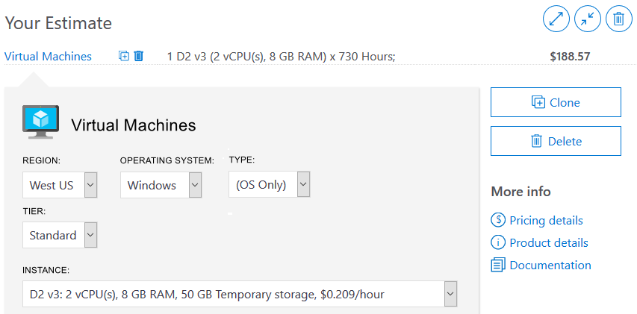
Pricing calculator
Helps you estimate the you need and configure them according to your specific requirements
Azure provides a detailed estimate of the costs associated with your selections and configurations
Notes:
You might want to demonstrate the Pricing calculator at https://azure.microsoft.com/en-us/pricing/calculator/
Note: The pricing calculator provides estimates, and not actual price quotes. Actual prices can vary depending upon the date of purchase, the payment currency, and the type of Azure customer.
Get a new estimate from the pricing calculator by adding, removing, or reconfiguring selected products. You also can access pricing details, product details, and documentation for each product from the pricing calculator.

Slide 16
Demo: Generate an Azure Pricing Calculator estimate

Slide 17
Walkthrough-Generate an Azure Pricing Calculator estimate
In this walkthrough, you will generate and then download a cost estimate for a specific resource configuration in Azure, using the Azure Pricing Calculator. The estimate will outline the costs of running a Virtual Machine (VM) and related network resources in Azure.
You can complete this walkthrough task by completing the steps outlined below, or you can simply read through them, depending on your available time
Notes:
Students can just read through the tasks and get a feel for how they work or actually step through them like a lab task.
Another option could be to complete the walkthrough at the end of the module, and complete all or some of the walkthroughs in the module together at that stage, like an end of module or even end of course lab.
Steps
1. In a browser, navigate to the Azure Pricing Calculator webpage, https://azure.microsoft.com/en-us/pricing/calculator/.
2. To add details of your VM configuration, select Virtual Machines from the Products tab. Inside the Virtual Machines added message dialog, choose View.
3. Enter a name for your Azure Pricing Calculator estimate, and a name for your VM configuration. This walkthrough example uses My Pricing Calculator Estimate for the estimate, and Windows VM for the VM configuration.
4. Modify the default VM configuration to match the following VM details.
Region Operating system Type North Europe Windows (OS ony) Tier Instance Standard A2: 2 Core(s), 3.5 GB RAM, 135 GB Temporary storage
Note: The VM instance specifications and pricing may differ from those in this example. Follow this walkthrough by choosing an instance that matches the example as closely as possible. To view details about the different VM product options, choose Product details from the More info menu on the right.
5. Set the Billing Option to Pay as you go.
6. In Azure, a month is defined as 730 hours. If your VM needs to be available 100 per cent of the time each month, you set the hours-per-month value to 730. This walkthrough example requires one VM to be available 50 per cent of the time each month.
Leave the number of VMs set at 1, and change the hours-per-month value to 365.
7. In the Managed OS Disks pane, modify the default VM storage configuration by adding the following details.
Tier Disk size Number of disks Snapshot Storage transactions Standard HDD S30: 1024 GiB 1 Off 10,000
8. To add networking bandwidth to your estimate, go to the top of the Azure Pricing Calculator webpage. Select Networking from the product menu on the left, then choose the Bandwidth tile. Inside the Bandwidth added message dialog, select View.
9. Add a name for your VM bandwidth configuration. This walkthrough example uses the name Bandwidth: Windows VM. Modify the default bandwidth configuration by adding the following details.
Region=North Europe
Zone 1=Outbound Data Transferer Amount=50 GB
10. To add an Application Gateway, return to the top of the Azure Pricing Calculator webpage. From within the Networking product menu, choose the Application Gateway tile. Inside the Application Gateway message dialog, select View.
11. Add a name for your Application Gateway configuration. This walkthrough uses the name App Gateway: Windows VM. Modify the default Application Gateway configuration by adding the following details.
Region Tier Size North Europe Basic Small Instances Hours 1 365 Data processed 50 GB Zone 1: North America, Europe 50 GB
12. Go to the bottom of the Azure Pricing Calculator webpage to view your total Estimated monthly cost.
Note: Explore the various options available within the Azure Pricing Calculator. For example, this walkthrough requires you to update the currency to Euro.
Change the currency to Euro, then select Export to download a copy of the estimate for offline viewing in Microsoft Excel (.xlsx) format.
Congratulations! You downloaded an estimate from the Azure Pricing Calculator.

Slide 18
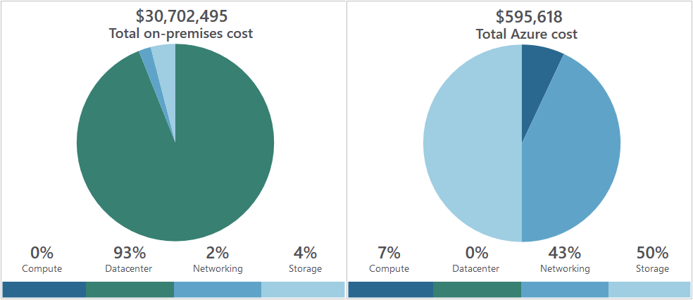
Total cost of ownership (TCO) calculator
A tool that you use to estimate cost savings you can realize by migrating to Azure
A report compares the costs of on-premises infrastructures with the costs of using Azure products and services to host infrastructure in the cloud
Notes:
You might want to demonstrate the TCO calculator at https://azure.microsoft.com/en-us/pricing/tco/calculator/
To use the TCO calculator, complete the following three steps:
1. Define your workloads:
Enter details about your on-premises infrastructure into the TCO calculator according to four groups:
Servers. Enter details of your current on-premises server infrastructure.
Databases. Enter details of your on-premises database infrastructure in the Source section, and select the corresponding Azure service you would like to use in the Destination section.
Storage. Enter the details of your on-premises storage infrastructure.
Networking. Enter the amount of network bandwidth you currently consume in your on-premises environment.
2. Adjust assumptions:
Adjust the values of key assumptions that the TCO calculator makes, which might vary between customers. To improve the accuracy of the TCO calculator, adjust the values so they match the costs of your current on-premises infrastructure:
Storage costs
IT labor costs
Hardware costs
Software costs
Electricity costs
Virtualization costs
Datacenter costs
Networking costs
Database costs
3. View the report.

Slide 19
Demo: Generate an Azure TCO Calculator cost comparison report

Slide 20
Walkthrough-Generate an Azure TCO Calculator cost comparison report
In this walkthrough, you will generate and then download a cost comparison report for workloads running in an on-premises environment versus running in Azure, using the Total Cost of Ownership (TCO) Calculator. The TCO Calculator will use information that you provide about your on-premises infrastructure and workloads to recommend cost savings that you can make with Azure.
You can complete this walkthrough task by completing the steps outlined below, or you can simply read through them, depending on your available time
Notes:
Students can just read through the tasks and get a feel for how they work or actually step through them like a lab task.
Another option could be to complete the walkthrough at the end of the module, and complete all or some of the walkthroughs in the module together at that stage, like an end of module or even end of course lab.
Steps
1. In a browser, navigate to the Total Cost of Ownership (TCO) Calculator webpage, https://azure.microsoft.com/en-us/pricing/tco/calculator/.
2. To add details of your on-premises server infrastructure, select + Add server workload in the Servers pane.
3. Provide a name for your server workloads definition. This example uses the name Servers: Windows VMs. Enter the following details into the TCO Calculator.
Workload=Windows/ Linux server
Environment=Virtual machines
Operating system=Windows
VMS=500
Virtualization=VMware
Core(s)=8
RAM=16
Optimize=CPU
4. Select + Add server workload to make a row for a new server workloads definition. Provide a name for the server workloads definition. This example uses the name Servers: Linux VMs. Enter the following details into the TCO Calculator.
Workload=Windows/ Linux server
Environment=Virtual machines
Operating system=Windows
VMS=500
Virtualization=VMware
Core(s)=8
RAM=16
Optimize=CPU
5. This example definition does not require a database. Leave the Databases pane empty. In the Storage pane of the TCO Calculator, provide a name for your storage infrastructure definition. Enter the following details into the TCO Calculator.
Storage type=Local Disk/ SAN
Disk type=HDD
Capacity=60 TB
Backup=0 TB
Archive=0 TB
6. In the Networking pane of the TCO Calculator, enter the following details, then select Next.
Outbound bandwidth 15 TB
7. Explore the options and make any adjustments that you require. The currency used in this example is Euros. No other adjustments are required by this example. Select Next, at the end of the page.
8. Review the Azure cost saving recommendations and visualizations in the TCO calculator report. This example requires you to adjust the Timeframe to 3 years, and the region to North Europe.
9. To modify the information you provided to the TCO calculator, go to the bottom of the page, and select Back. To save or print a PDF copy of the report select Download.
Congratulations! You downloaded a cost comparison report from the TCO Calculator in Azure.

Slide 21
Minimizing costs
The following best practice guidelines can help minimize your Azure costs:
Perform cost analyses: Use the Azure Pricing and TCO calculators
Monitor usage with Azure Advisor: Implement recommendations
Use spending limits: Use via free trial customers and some credit-based Azure subscriptions
Use Azure Reservations: To get a discount, reserve products and resources by paying in advance. Prepay for 1 or 3 years, and achieve up to 72% savings over pay-as-you-go costs
Choose low-cost locations and regions: If possible, use low-cost locations
Apply tags to identify cost owners: Identify usage owners with tags
Notes:
Perform cost analyses
Plan your Azure solution wisely. Carefully consider the products, services, and resources you need, and read the relevant documentation to understand how each of your choices are metered and billed. Additionally, calculate your projected costs by using the Azure Pricing and Total Cost of Ownership (TCO) calculator, only adding the products, services, and resources you need.
Monitor usage with Azure Advisor
In an efficient architecture, provisioned resources match the demand for those resources. Azure Advisor identifies unused or under-utilized resources, and you can implement its recommendations by removing unused resources and configuring your resources to match your actual demand.
Use spending limits
Free trial customers and some credit-based Azure subscriptions can use spending limits, which Azure provides to help prevent customers from exhausting the credit on their account within each billing period. If you have a credit-based subscription and you reach your configured spending limit, Azure suspends your subscription until a new billing period begins.
The spending limit feature is not available for customers who aren't using credit-based subscriptions, such as Pay-As-You-Go subscribers.
For more information on Azure spending limits, refer to https://docs.microsoft.com/en-us/azure/billing/billing-spending-limit
Note: Azure spending limits are not the same as Subscription, Service, or Resource Group limits and quotas. For more information, refer to https://docs.microsoft.com/en-us/azure/azure-subscription-service-limits
Use Azure Reservations
Azure Reservations offer discounted prices on certain Azure products and resources. To get the discount, reserve products and resources by paying in advance. You can pre-pay for one or three years of use of:
Virtual machine (VM)
SQL Database Compute Capacity
Azure Cosmos Database Throughput
Other Azure resources
Azure Reservations are only available to Microsoft Azure Enterprise or CSP customers, and for Pay-As-You-Go subscriptions.
For more information on Azure Reservations, visit https://docs.microsoft.com/en-us/azure/billing/billing-save-compute-costs-reservations
Choose low-cost locations and regions
The cost of Azure products, services, and resources can vary across locations and regions. Some resources are metered and billed according to how much outgoing network bandwidth they consume (egress). If possible, provision connected resources that are bandwidth metered in the same region to reduce egress traffic between them. Also, If possible, use locations and regions where they cost less.
Research available cost-saving offers
Keep up-to-date with the latest Azure customer and subscription offers, and switch to offers that provide the greatest cost-saving benefit.
Apply tags to identify cost owners
Tags help you manage costs associated with the different groups of Azure products and resources. You can apply tags to groups of Azure products and resources to organize billing data. For example, if you run several virtual machines for different teams, you can use tags to categorize costs by department (such as Human Resources, Marketing, or Finance), or by environment (such as Production or Test). Tags make it easier to identify groups that generate the biggest Azure costs so you can adjust your spending accordingly.

Slide 22
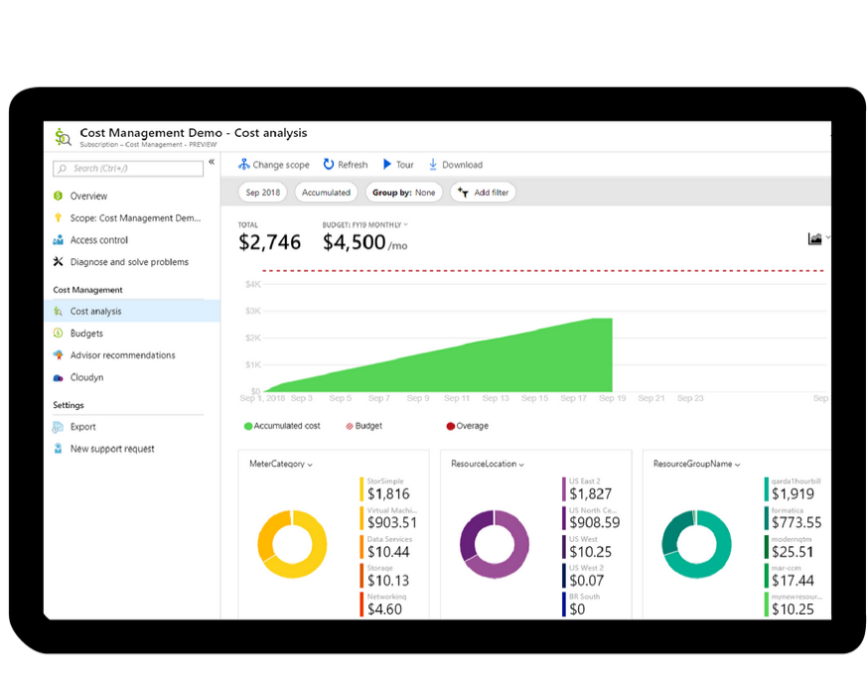
Azure Cost Management
Azure Cost Management is an Azure product that provides a set of tools for monitoring, allocating, and optimizing Azure costs, it provides the following:
Reporting: Generates reports
Data enrichment: Improves accountability by categorizing resources with tags
Budgets: Monitors resource demand trends, consumption rates, and cost patterns
Alerting: Provides alerts based on your cost and usage budgets
Recommendations: Provides recommendations to eliminate idle resources and to optimize provisioned Azure resources
Notes:
Note: For more information about Cost Management, refer to https://azure.microsoft.com/en-us/services/cost-management/

Slide 23
Lesson 04: Support options available with Azure

Slide 24
Support plan options
Every Azure subscription includes:
Free access to billing and subscription support
Azure products and services documentation
Online self-help documentation
Community support forums
Paid Azure support plans:
Developer. For Azure use in trial and nonproduction environments
Standard. Appropriate for Azure use in production environments
Professional Direct. Appropriate for organizations with business-critical dependence on Azure
Premier. Ideal for organizations with substantial dependence on Microsoft products, including Azure.
Notes:
Support plans:
Developer. Developer support is appropriate for Azure use in trial and nonproduction environments. It includes business hours access to support engineers via email, minimum business impact (severity C) incident submission, and less than eight business hours for initial response time.
Standard. Standard support is appropriate for Azure use in production environments. It includes access to support engineers via email and phone 24 hours a day, seven days a week. Critical business impact (severity A) incident submission includes less than one hour initial response time for severity A incidents.
Professional Direct. Professional Direct (ProDirect) is appropriate for organizations with business-critical dependence on Azure. The ProDirect option includes all features of the Standard option, and:
Escalation management for priority issues.
Proactive guidance from a team of ProDirect Delivery Managers.
Onboarding services, service reviews, and Azure Advisor consultations.
Architectural guidance based on best practices.
Azure Engineering-led web seminars.
Premier. Premier support is ideal for organizations with substantial dependence on Microsoft products, including Azure. This solution includes all features of ProDirect, and:
Support assistance for all Microsoft products and services.
Less than 15 minutes initial response time with Azure Rapid Response (requires an additional fee).
Service reviews and reporting delivered by a designated technical account manager.
Customer-specific architectural support such as design reviews, performance tuning, and configuration.
implementation assistance delivered by Azure technical specialists.
Support-plan availability and billing
The support plans you select and how you are billed for support depends on the type of Azure customer you are, and the type of Azure subscription you have. For example, Developer support is not available to Enterprise customers. Instead, Enterprise customers can purchase Standard, Professional Direct, and Premier support plans, and be billed for support as part of an Enterprise Agreement (EA). Conversely, if you purchase a support plan within a pay-as-you-go subscription, your support plan is charged to your monthly Azure subscription bill.
For more information about Azure support options, refer to https://azure.microsoft.com/en-us/support/plans/

Slide 25





Alternative support channels
Other support channels available outside of the Azure official support plans:
Microsoft Developer Network (MSDN) Azure Forums.
Stack Overflow
Server Fault
Azure Feedback Forums at Microsoft Azure general feedback
Twitter. Tweet @AzureSupport to get answers and support
Notes:
For more information about alternative Azure support channels, refer to https://azure.microsoft.com/en-us/support/community/

Slide 26
Knowledge Center
Azure Knowledge Center is a searchable database that contains support questions and answers from a community of Azure experts, developers, customers, and users
Browse through all answers within the Azure Knowledge Center by entering keyword search terms into the text-entry field and further refine your search results by selecting products or tags from the dropdown lists
See Azure Knowledge Center for more information
Notes:
For more information about alternative Knowledge Center, refer to https://azure.microsoft.com/en-us/resources/knowledge-center/

Slide 27
Walkthrough-Open a Support Request
In this walkthrough task we will view available support plan options and then create a new support request. Once created we will then see how to monitor and interact with a support request.
You can complete this walkthrough task by completing the steps outlined below, or you can simply read through them, depending on your available time
Notes:
In this walkthrough task we will view available support plan options and then create a new support request. Once created we will then see how to monitor and interact with a support request.
Prerequisites
You require need an Azure subscription to perform these steps. If you don't have one you can create one by following the steps outlined on the Create your Azure free account today webpage.
costs for running resources. You can delete all deployed resources by deleting the resource group in which they all reside.
Steps
View available support plan options and create a new support request
1. Log into the Azure portal.
2. Choose Help + support from the left navigation menu, to open the Help + Support blade:
3. On the Help + Support blade, select New support request, then on the Basics tab fill in the fields as below. Once finished click Next: Solutions >>. The fields which appear are dependant on the values you placed in the preceding field.
- Issue type: Technical
- Subscription: < choose your subscription >
- Service: < check the radio button All services then scroll down through the drop down list of issues, and select Virtual Machine running Linux >
- Problem Type: VM performance
- Problem subtype: Disk throughput is lower than expected
- Subject: Slow disk perf
Note: All Azure customers can access billing, quota, and subscription-management support. *The availability of support for other issues depends on the support plan you have*.
4. On the New support request > Solutions tab read through the recommended solutions then click Next: Details >>
5. On the New support request > Details tab read the message stating what support you are entitled to access with your current support plan, click View Plans and view the support plan options that we are currently entitled to and those we can upgrade to, along with the details, and costs of them i.e. we can upgrade to Developer, Standard or Professional Direct
Note: If you have existing support benefits, not appearing for your subscription, you can add them by clicking Link support benefits and providing your *Access* and *Contract ID*.
6. Still on the Details tab, click the Azure community support link. You are brought to the Azure community Support page where you can access community support and resources such as the MSDN Forums, StackOverflow, Serverfault, Azure Feedback and more support options.
7. Return to the New support request section and the Basics tab fill in the fields as below. We will modify our selections to allow us create a support ticket under our Pay-As-You-Go subscription i.e. we will create a support request in the concerning billing for which we we are entitled to access Microsoft support. Once finished click Next: Solutions >>.
- Issue type: Billing
- Subscription: < choose your subscription >
- Problem Type: Assistance with Bill or Usage
- Problem subtype: My issue is not listed here
- Subject: Test Issue - Charge Query
8. On the Solutions tab, have a quick look at the recommendations and then click Next: Details >>
9. On the Details tab fill in the fields as below, we will not fill in all fields in the interest of time, however when submitting a real support request you should provide as much information as possible to allow for a speedy resolution of the issue. Click Next: Review + create >> when finished.
- Problem start date: todays date
- Please provide details about your issue: Test Issue
- Severity: B-moderate impact
- Preferred contact method: contact me later > email
- Response hours: Business hours
- Support language: < enter your preferred language >
- Contact info: Enter your own personal contact details >
10. On the Review + create tab review the information and click Create
11. After it is created, in the Notifications area, there is a notifcation of the New Support request having been created and a support request number is displayed.
12. An email is also sent to your email address containing details of the support request.
Monitor and interact with a support request
1. To check the status and details of your support request, go to Help + support and then in the Help + support pane choose All support requests. Your support request should now be listed.
2. Double click the new support request and within the support request pane, you can view status, change severity, modify contact details, upload files and send messages related to the request.
Note: It is not currently possible for a user who opened a support request, to close it themselves. The Microsoft support team will review the item, and contact the user who opened the support request to verify they can close the support request. You can leave this support request as is for now, and later, when contacted by support, verify it is fine to close the support request.
If you would like to provide feedback to Microsoft regarding adding this as a feature, go to the https://feedback.azure.com/forums/34192--general-feedback page, and search to see if the issue is open already and vote for it, or add it as a new issue.
Congratulations! You have viewed available support plan options, and then created a new support request. You then saw how to monitor and interact with a support request.
Note: For more information about creating an Azure support ticket, refer to https://azure.microsoft.com/en-us/support/create-ticket/"

Slide 28
Lesson 05: Azure Service Level Agreements (SLAs)

Slide 29
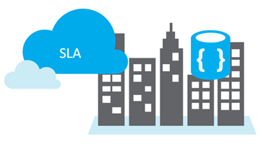
Service Level Agreements (SLAs)
SLAs document the specific terms that define Azure performance standards
SLAs define Microsoft’s commitment to an Azure service or product
Individual SLAs are available for each Azure product and service
SLAs also define what happens if a service or product fails to meet the designated availability commitments

Slide 30
SLAs for Azure products and services
Three key characteristics of SLAs for Azure products and services:
Performance targets, uptime and connectivity guarantees: Uptime or connectivity rates, such as availability
Performance targets range: Typical SLAs specify performance-target commitments ranging from 99.9 percent (three nines) to 99.99 percent (four nines)
Service credits: Percentage of the applicable monthly service fees credited to you if a service fails to meet ALS uptime guarantee
For more information about specific Azure SLAs for individual products and services, see Service Level Agreements
Notes:
Performance Targets, Uptime and Connectivity Guarantees
An SLA defines performance targets for an Azure products and services.
Performance targets range from 99.9 percent to 99.99 percent
A typical SLA specifics performance-target commitments that range from 99.9 percent (three nines) to 99.99 percent (four nines).
Service Credits
SLAs also describe how Microsoft will respond if an Azure product or service fails to perform to its governing SLA's specification. For example, customers could have a discount applied to their Azure bill as compensation for an under-performing Azure product or service. An example is in the table below for single instance Azure VMs where if the monthly uptime percentage is less than the specified value, you receive the corresponding service credit, or discount.
| MONTHLY UPTIME PERCENTAGE | SERVICE CREDIT |
| --- | --- |
| < 99.9% |10% |
| < 99% |25% |
| < 95% |100% |
Note: For a lot of Azure services, no SLA is provided for services under either the Free or Shared tiers. Also, Free products such as Azure Advisor do not typically have an SLA.
You might want to browse to some SLA’s directly https://azure.microsoft.com/en-us/support/legal/sla/summary/ and explore one or two as examples.

Slide 31
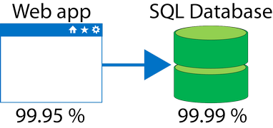
Composite SLAs
At the time of this writing, an App Service web app that writes to Azure SQL Database has the following SLAs:
App Service Web Apps is 99.95 percent
SQL Database is 99.99 percent
Question: What is the maximum downtime you would expect for this application, as across?
Answer: The composite SLA for this application is 99.95% × 99.99% = 99.94%.
This is lower than the individual SLAs. However, you can construct SLAs to improve overall application SLA.

Slide 32
Improving application SLAs
Azure customers can use SLAs to evaluate how their Azure solutions meet their business requirements, and the needs of their clients and users. By creating their own SLAs, organizations can set performance targets to suit their specific Azure application. This is known as an application SLA.
Considerations for defining application SLAs:
Self Healing: Your Azure solution should be self-diagnosing and self-healing
Response Time: Responding to failures quickly enough to meet SLA performance targets above four 9’s are difficult to meet
Realistically Achievable: The smaller the time window for recovery (for example, hourly or daily) the tighter the tolerances and higher the cost
Notes:
You could also discuss about the following topics if you have time.
Resiliency
Resiliency is the ability of a system to recover from failures and continue to function. It's not about avoiding failures but responding to failures in a way that avoids downtime or data loss. The goal of resiliency is to return the application to a fully functioning state following a failure. High availability and disaster recovery are two important components of resiliency.
Cost and complexity vs. high availability
Availability refers to time that a system is functional and working. Maximizing availability requires implementing measures to prevent possible service failures. However, devising preventative measures can be difficult and expensive, and often results in very complex solutions.
For more information about improving application SLAs, refer to https://docs.microsoft.com/en-us/azure/architecture/resiliency/

Slide 33
Improving application SLAs - continued
The following table lists the potential cumulative downtime for various SLA levels over different durations
SLA | Downtime per week | Downtime per month | Downtime per year
99% | 1.68 hours | 7.2 hours | 3.65 days
99.9% | 10.1 minutes | 43.2 minutes | 8.76 hours
99.95% | 5 minutes | 21.6 minutes | 4.38 hours
99.99% | 1.01 minutes | 4.32 minutes | 52.56 minutes
99.999% | 6 seconds | 25.9 seconds | 5.26 minutes

Slide 34
Walkthrough-Calculate Composite SLA for an Application
In this walkthrough task we will determine the SLA uptime percentages for each of the services in a sample application and then calculate the composite SLA uptime percentage for our application.
You can complete this walkthrough task by completing the steps outlined below, or you can simply read through them, depending on your available time
Notes:
In this walkthrough task we will determine the SLA uptime percentages for each of the services in a sample application and then calculate the composite SLA uptime percentage for our application.
In our sample scenario our application consists of the below Azure services.
- Web App service: To host the application
- Azure AD B2C: To authenticate user login, manage profiles
- Application Gateway: To manage application access, scaling, Firewall
- SQL Database: To store application data. It will be a general purpose database, running as standard tier, not configured for Zone Redundant Deployments. It will have two replicas.
Prerequisites
There are no prerequisites. You do not need an Azure subscription.
Steps
Determine the SLA uptime percentage values for our application
1. Go to the https://azure.microsoft.com/en-us/support/legal/sla/summary/" page
2. On the SLA webpage locate the Azure Active Directory B2C service and determine SLA uptime value, and note it down i.e. 99.9%. You can also scroll down to the SLA detail section to determine more SLA detail such as Service Credit
3. On the SLA webpage locate the Azure App Service SLA uptime value and note it down, i.e. 99.95%. You can also scroll down to the SLA detail section to determine more SLA detail such as Service Credit
4. On the SLA webpage locate the Azure Application Gateway SLA uptime value and note it down, i.e. 99.95%. You can also scroll down to the SLA detail section to determine more SLA detail such as Service Credit
5. On the SLA webpage locate the Azure SQL Database SLA uptime value for the configuration we have specified earlier, and note it down, i.e. 99.99%. You can also scroll down to the SLA detail section to determine more SLA detail such as Service Credit
Note: There are different uptime values for different configurations and deployments of Azure SQL Database. It is important you are clear on your required uptime values, when planning and costing your deployment and configuration. Small changes in uptime can have impact on service costs as well as potentially increase complexity in configuration. Some other services that may be of interest to look at for examples on the Azure SLA summary web page would include Virtual Machines, Storage Accounts and Cosmos DB.
Calculate the Application Composite SLA percentage uptime
1. If any of the services that comprises our application are not available our application will not be available for users to sign in to and use. As such the total uptime for our application consists of the following:
Azure AD B2C % uptime X App Service % uptime X Azure Application Gateway % uptime X Azure SQL Database % uptime = Total % Uptime
which in percentage term is as follows:
99.9% X 99.95% X 99.95% X 99.99% = 99.79%
This is the percentage uptime that our application will be able to achieve with the current services and architecture.
Congratulations! You have determined the SLA uptime percentages for each of the services in our sample application and then calculated the composite SLA uptime percentage for the application.
Note: Remember to delete the resources you have just deployed, if they are still present and you are no longer using them to ensure you do not incur costs for running resources. You can delete all deployed resources by deleting the resource group in which they all reside.

Slide 35
Lesson 06: Service lifecycle in Azure

Slide 36
Public and private preview features
Microsoft offer previews of Azure features for evaluation purposes.
With Azure previews, you can test beta and other pre-release features, products, services, software, and regions.
There are two types of Azure preview modes:
Private Preview: An Azure feature is available to certain Azure customers for evaluation purposes
Public Preview: An Azure feature is available to all Azure customers for evaluation purposes
Notes:
Some preview features are not covered by customer support.
For more information about Azure Previews, visit https://azure.microsoft.com/en-us/services/preview/

Slide 37
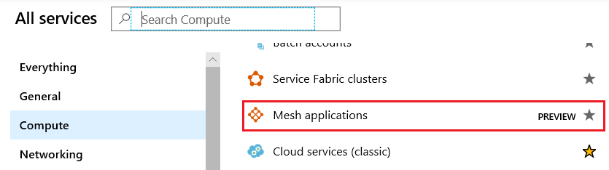
Accessing preview features
Preview - New Services:
Accessible via the Azure Portal
Indicated by the presence of a Preview label on the service
Preview - New Functionality/Features within an existing service:
Some preview features are accessible as you deploy, configure and manage an existing service for example Azure Kubernetes cluster version
Notes:
You could demonstrate the below
Preview - New Services:
You can view preview services by doing the following:
Sign into the Azure Portal
Click Create a resource
Type preview in the search box and press Enter
A list of services is returned and displayed for you to browse through. You can select one to learn more about it, and also create an instance of the service and try it out.
Preview - New Functionality/Features within an existing service:
Some preview features relate to a specific area of an existing Azure Service. These preview features are accessible as you deploy, configure and manage the particular service. One such example is Azure Kubernetes Service (AKS), where you can view preview functionality available within AKS by doing the following.
Sign in to Azure portal
Open the Azure Kubernetes Services (AKS) then click Create Kubernetes service button
Under the Cluster Details > Kubernetes version section expand the drop down list tro display versions.
The latest version 1.14.0 is listed as currently in preview i.e. 1.14.0 (preview). It is being made available to provide new functionality in AKS and allow testing.

Slide 38

Accessing Azure Portal Preview
You can access preview features that are specific to the Azure Portal from the https://preview.portal.azure.com page.
Typical portal preview features provide performance, navigation, and accessibility improvements to the Azure portal interface.
Providing Feedback
Typical portal preview features provide performance, navigation,
and accessibility improvements to the Azure portal interface
Feedback on the portal preview features can be submitted by sending a smile in the portal or by posting ideas and suggestions on the Azure Portal Feedback Forum

Slide 39
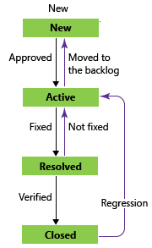
General Availability
Once a feature is evaluated and tested successfully, it might be released to customers as part of Azure's default product, service, or feature set
Bugs for features and products go through their lifecycle as in the graphic across.
Once the feature meets a specific criteria the feature is released to all Azure customers, and this release is referred to general availability.

Slide 40
Monitoring feature updates
Information about the latest updates to Azure products, services, and features, and product roadmaps, and announcements are available at Azure updates
Azure updates page:
View details about all Azure updates
See which updates are in general availability, preview, or development
Subscribe to Azure update notifications by RSS
Notes:
From the Azure updates page, you can:
View details about all Azure updates.
See which updates are in general availability, preview, or development.
Browse updates by product category or update type by using the provided dropdown lists.
Search for updates by keyword by entering search terms into a text-entry field.
Subscribe to get Azure update notifications by RSS.
Access the Microsoft Connect page to read Azure product news and announcements.
For more information about Azure updates, refer to https://azure.microsoft.com/en-us/updates/

Slide 41
Walkthrough-Access Azure Preview features
In this walkthrough task we will access preview services and features in Azure and then identify preview service and feature information, and latest information on the Azure Updates.
You can complete this walkthrough task by completing the steps outlined below, or you can simply read through them, depending on your available time
Notes:
In this walkthrough task we will access preview services and features in Azure and then identify preview service and feature information, and latest information on the Azure Updates.
Prerequisites
- You require an Azure subscription to perform these steps. If you don't have one you can create one by following the steps outlined on the https://azure.microsoft.com/en-us/free/ webpage.
Steps
Access preview services and features
1. Go to Azure Portal, click on Create a resource, and in the Search the Marketplace box type preview and press Enter
2. In the Marketplace > Get Started pane a list of services in Preview is returned.
3. Locate the DNS Analytics (Preview) service in the list of services, open it and click Create
4. You can proceed and create a Log Analytics workspace as prompted, and start to use and work with DNS Analytics if you wish, however there is no need to do so and we will not do so here as the intention is just to demonstrate its availability and demonstrate a preview services usage.
5. Close the DNS Analyzer panes, and in the Azure Portal go to All services > Compute. Note the presence of services listed as Preview
Click on several other groupings, such as Network, Storage, Internet of Things and note the presence of preview services listed and available.
6. View preview functionality in an existing service by locating and opening the Azure Kubernetes Service (AKS) and in the Kubernetes services pane select Create Kubernetes service
7. In the Create Kubernetes cluster pane go to the Cluster details section and expand the drop-down list and select 1.14.0 (preview). This is a preview version of Kubernetes. This preview version is to allow users gain access to new functionality as soon as possible.
Note: In these scenarios, where new functionality or features are made available within an existing generally available Azure service or product, although you may be using the Azure service in production, the preview feature or functionality may not yet be ready for production deployments. And you should make sure you are aware of any limitations around its use before deploying to production.
Identify preview information and latest information on the Azure Updates page
1. Go to the Azure Updates page https://azure.microsoft.com/en-us/updates/ Note the presence of four tab options i.e. All, Now Available, In preview and In development
2. Click on the In preview tab and type Kubernetes in the search for a search box, then select Azure Kubernetes Service (AKS) when prompted. The page returns a list of items in preview related to Kubernetes 3. Click on the first item in the list to get more details 4. Click the Learn more link and you are brought to a blog announcement re the preview feature. There is more detail available on this page and links to further documentations and details. 5. You can repeat steps 1 to 4 for other products and services and see what other services have preview features available.
6. Returning to the Azure Updates page, view items that are now have a status of General Availability by clicking Now available and noting the items now displaying
7. Now click on the In development tab and note the items returned that are currently in development. Congratulations! You have accessed preview services and features in Azure and identified preview service and feature information, and latest information on the Azure Updates.

Slide 42
Lesson 07: Module 4 review questions

Slide 43
Module 4 review questions
What is an Azure subscription?
What are some of the factors affecting costs?
What four paid plan types are available with Azure?
Notes:
Answers
Question 1:
An Azure subscription is a logical unit of Azure services that is linked to an Azure account. It can be used as a billing and a management boundary.
Using Azure requires an Azure subscription. Azure offer free and paid subscription options to suit different customer needs and requirements, and an account can have one or more subscriptions, with different billing models and access-management policies applied to each .
A subscription provides authenticated and authorized access to Azure products and services, and allows you to provision resources
Question 2:
Resource type and location are factors that affect costs.
Service usage rates and billing periods can also differ between Enterprise, Web Direct, and Cloud Solution Provider (CSP) customers.
You could also mention Azure Reservations, pre-paying for specific resources that you know you are going to use can also affect your costs.
Question 3:
Microsoft offers four paid support plans. Developer, Standard, Professional Direct, and Premier. Discuss when they are appropriate to use.
Developer. Azure use in trial and nonproduction environments
Standard. Appropriate for Azure use in production environments
Professional Direct. Appropriate for organizations with business-critical dependence on Azure
Premier. Ideal for organizations with substantial dependence on Microsoft products including Azure

